Slide 1
Hashed List Searches
The goal of a hashed search is to find the target data in only one test. After discussing some basic hashed list concepts, we discuss eight hashing methods. At the end of the section, we develop a hashing algorithm that uses several of the methods discussed in the section.
Basic Concepts
Hashing Methods
One Hashing Algorithm
Data Structures: A Pseudocode Approach with C, Second Edition

Slide 2
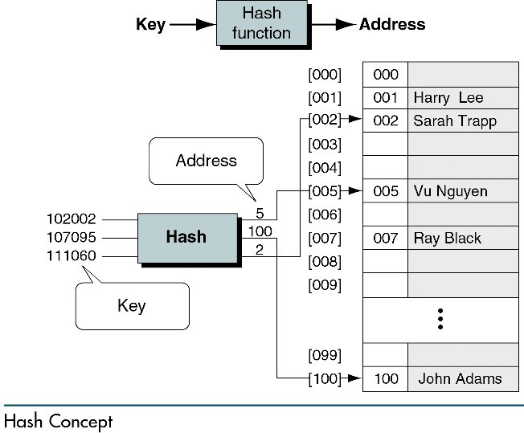
Data Structures: A Pseudocode Approach with C, Second Edition

Slide 3
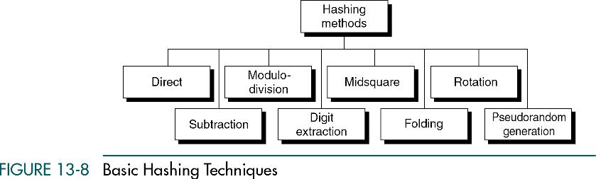
Data Structures: A Pseudocode Approach with C, Second Edition

Slide 4
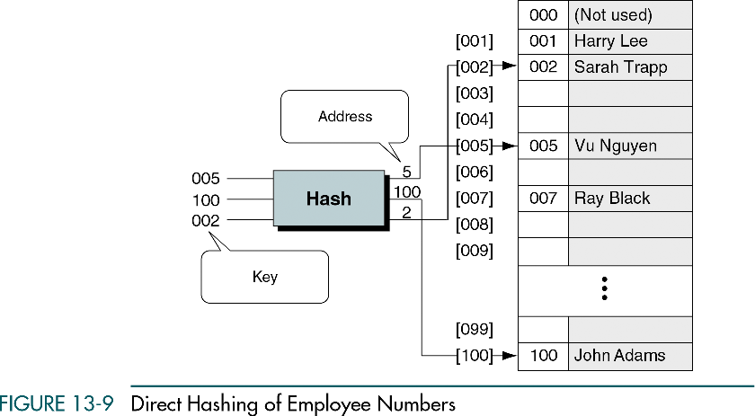
Data Structures: A Pseudocode Approach with C, Second Edition

Slide 5
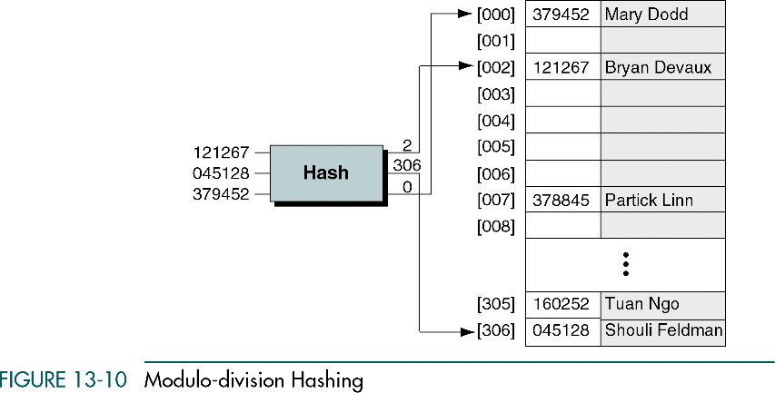
Data Structures: A Pseudocode Approach with C, Second Edition

Slide 6
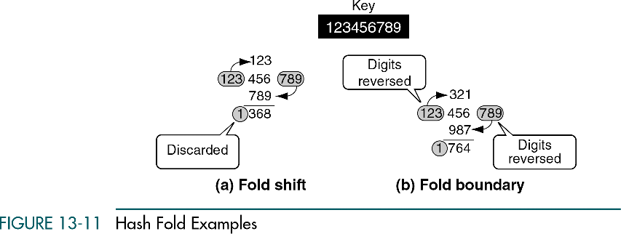
Data Structures: A Pseudocode Approach with C, Second Edition

Slide 7
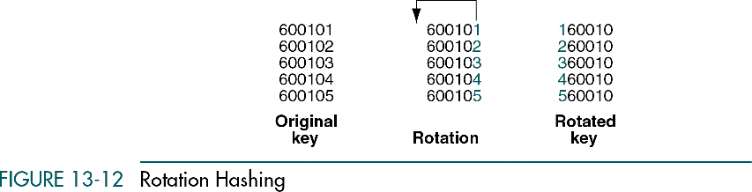
Data Structures: A Pseudocode Approach with C, Second Edition

Slide 8
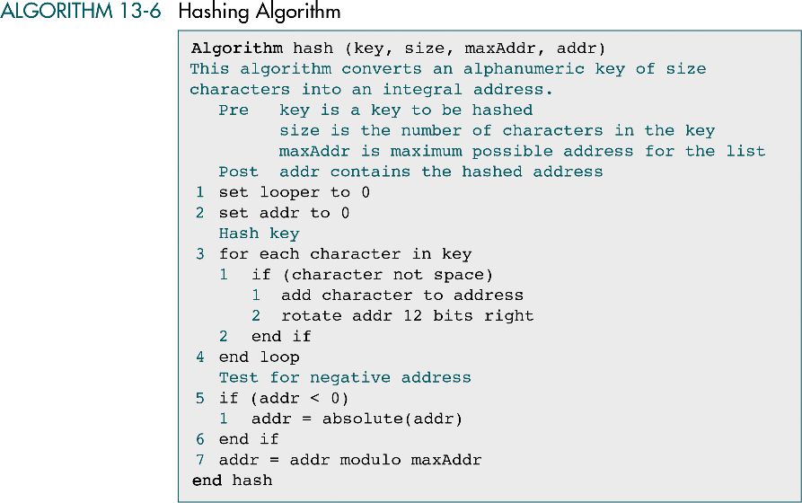
Data Structures: A Pseudocode Approach with C, Second Edition

Slide 9
Collision Resolution
We discuss three structural approaches and four specific collision resolution algorithms. At the end of the section, we develop a C program that builds and searches a hashed list.
Open Addressing
Linked List Collision Resolution
Bucket Hashing
Combination Approaches
Hashed List Example
Data Structures: A Pseudocode Approach with C, Second Edition

Slide 10
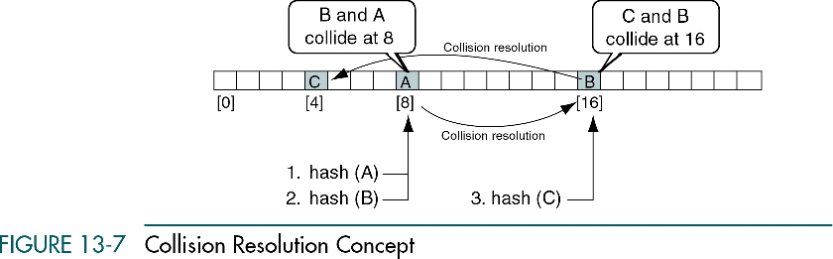
Data Structures: A Pseudocode Approach with C, Second Edition

Slide 11
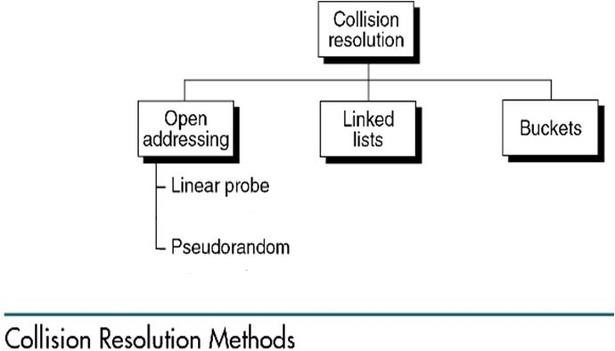
Data Structures: A Pseudocode Approach with C, Second Edition

Slide 12
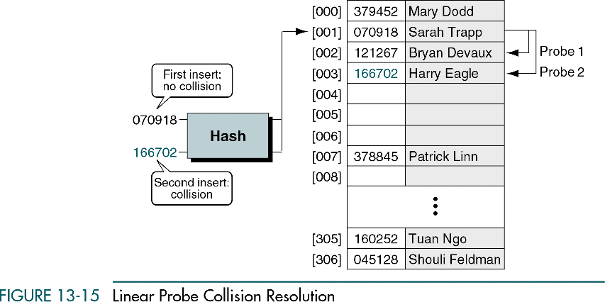
Data Structures: A Pseudocode Approach with C, Second Edition

Slide 13
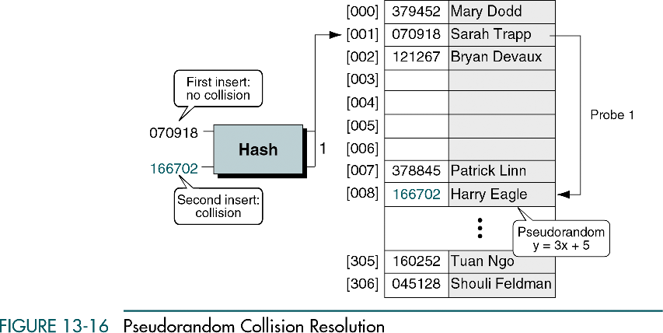
Data Structures: A Pseudocode Approach with C, Second Edition

Slide 14
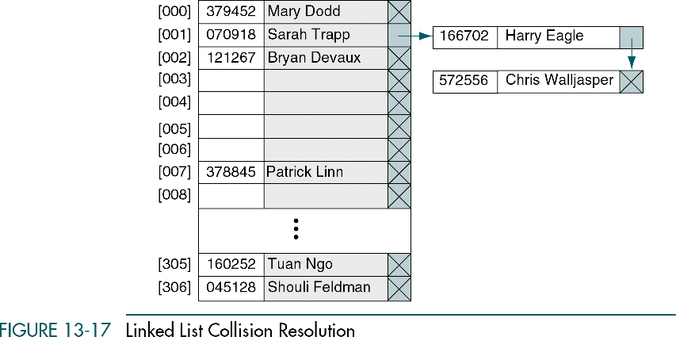
Data Structures: A Pseudocode Approach with C, Second Edition

Slide 15
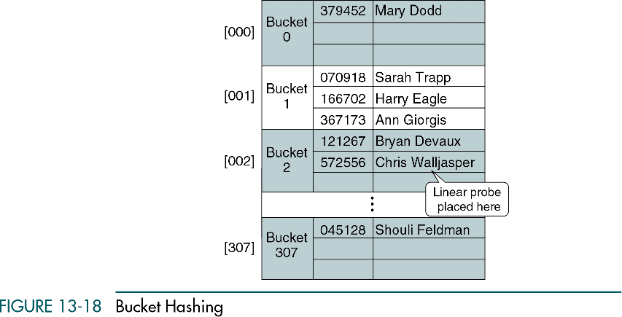
Data Structures: A Pseudocode Approach with C, Second Edition

